Slide 1
Smart egg rack giving you insights on family’s egg consumption
By Warren, Yingguang, tao, shijun

Slide 2
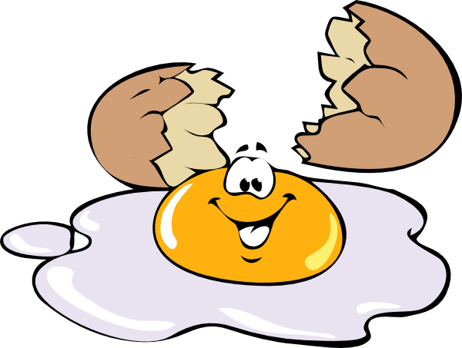
Pain points on eggs
Not know which one to use to maximize the overall storage time
Not know which ones may not be fresh
No automatic reminder to refill in advance
No overall insights on family’s egg consumption

Slide 3
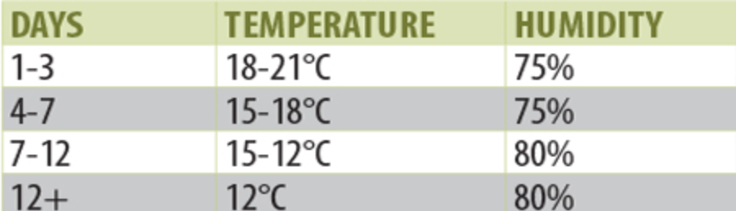
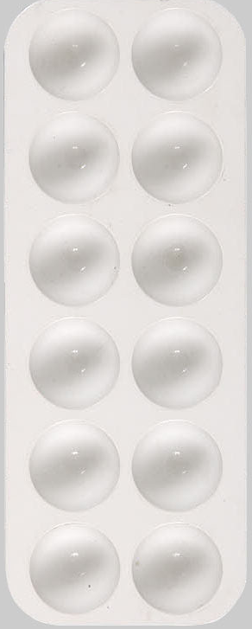
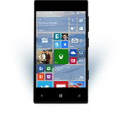
Our solutions
T: 5°C
H: 50%
Smart egg rack – a BT device+mobile app+Azure solution
Pressure sensors to detect load/unload
Push to let the led circle show best next(FIFO policy) and not freshs
Temp and humid sensors to calculate the storage time more intelligent
Record egg usage/waste and send to app
Mobile app sends data to azure sql, generate notifications and show Power BI reports
Pressure sensors

Slide 4
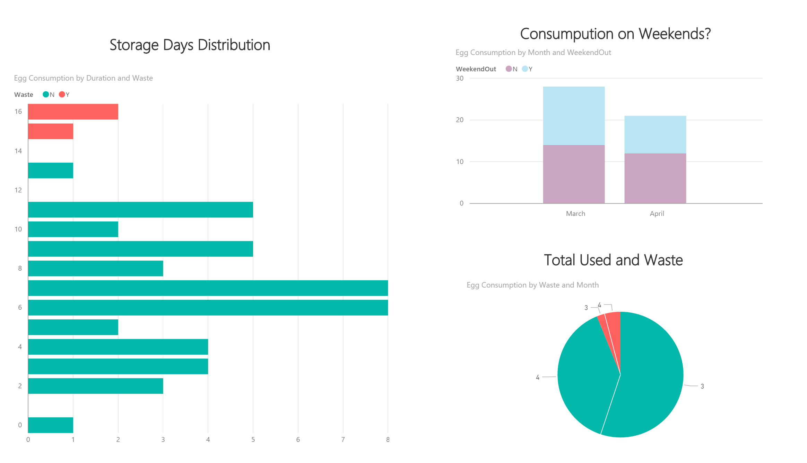
Family egg insights on power bi

Slide 5




architecture

